Slide 1

YouSpeak: Multilingual Summarizer for Short Videos with Interactive Q&A
Srikar Yadhunandan CS688 A2 – Web Mining and Graph Analytics

Slide 2
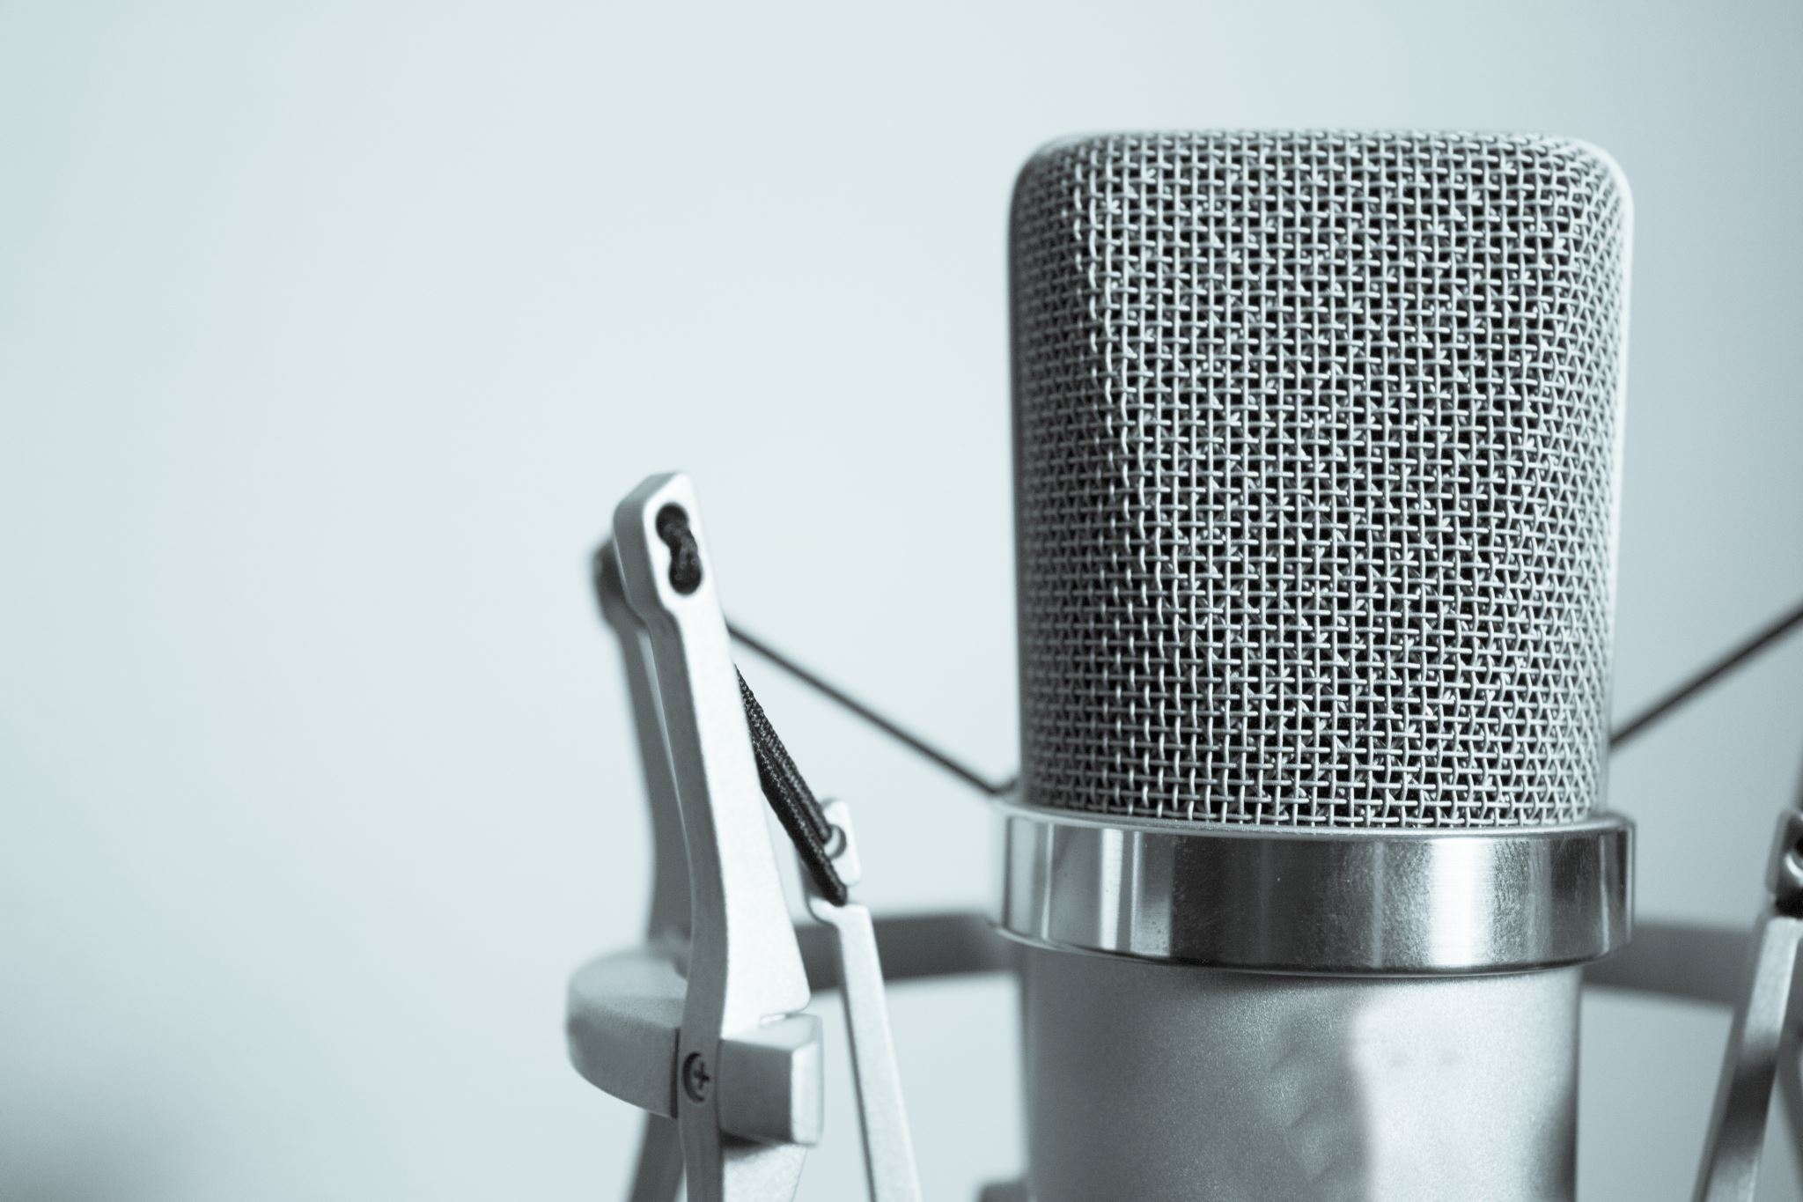
Problem Statement
Podcasts and spoken content are incredibly information-rich… and incredibly long.
Most users don’t have the time or patience to listen to hours of audio just to find the useful parts.
There's no built-in way to summarize, search, or translate podcasts efficiently.
Non-English speakers are often excluded from valuable audio content.

Slide 3

Objectives
Allow users to upload or link podcast audio (e.g., from YouTube).
Automatically transcribe spoken content into text using speech recognition.
Generate concise summaries from transcripts.
Translate those summaries into multiple languages (Hindi, French, Spanish).
Convert translated summaries into audio using text-to-speech.
Let users ask questions and get answers from the transcript like a mini-Google for podcasts.

Slide 4

System Architecture
Input: Audio file or YouTube link
Transcription: OpenAI Whisper converts speech to text
Summarization: HuggingFace transformer models shorten the text
Translation: MarianMT handles translation into multiple languages
Text-to-Speech: gTTS reads the translated summary aloud
Question Answering: DistilBERT model takes your question and finds the answer from the transcript

Slide 5

Tech Stack
Frontend/UI:
Streamlit (Python web app framework)
Core ML Models:
Whisper (speech-to-text)
Transformers (summarization and Q&A)
MarianMT (translation)
gTTS (text-to-speech)
Helpers:
yt-dlp (download YouTube audio)
fpdf (PDF export)
yake (keyword extraction)
vaderSentiment (sentiment analysis)

Slide 6
Audio Input Options
Upload any .mp3 or .wav file — works well with podcasts, lectures, etc.
Paste a YouTube link — system auto-downloads and extracts audio
Whisper performs best on English speech, but future versions may support multilingual inputs

Slide 7

Transcription & Summarization
Whisper model transcribes audio to high-quality text, even with background noise or multiple speakers
Summarization pipeline creates a short version of the full transcript — perfect for skimming
Both steps are automatic and require no user intervention

Slide 8
Multilingual Translation & Audio Generation
Summaries are automatically translated into Hindi, French, and Spanish using HuggingFace MarianMT models
Translations are then converted into speech using gTTS (Google Text-to-Speech)
Each summary is playable in the app as an audio file

Slide 9
Question Answering
User can type any question about the content of the transcript
A DistilBERT QA model finds the most relevant answer
It uses the full transcript as context (can be slow or dumb on long texts)
In future versions, transcript chunking and retrieval-augmented QA will improve this

Slide 10

Demo & Results
Full Streamlit interface:
Upload / YouTube input
Transcript shown in text box
Summary displayed below
Translated audio summary with playback
Q&A box and answers
Download summary as JSON or PDF

Slide 11

Future Work
Improve Q&A accuracy with chunked transcript handling
Add speaker identification using WhisperX or pyannote
Support non-English transcription
Better UI with tabs, loading spinners, and cleaner layouts
Deploy online for public use (Streamlit Cloud, HuggingFace Spaces, etc.)

Slide 12
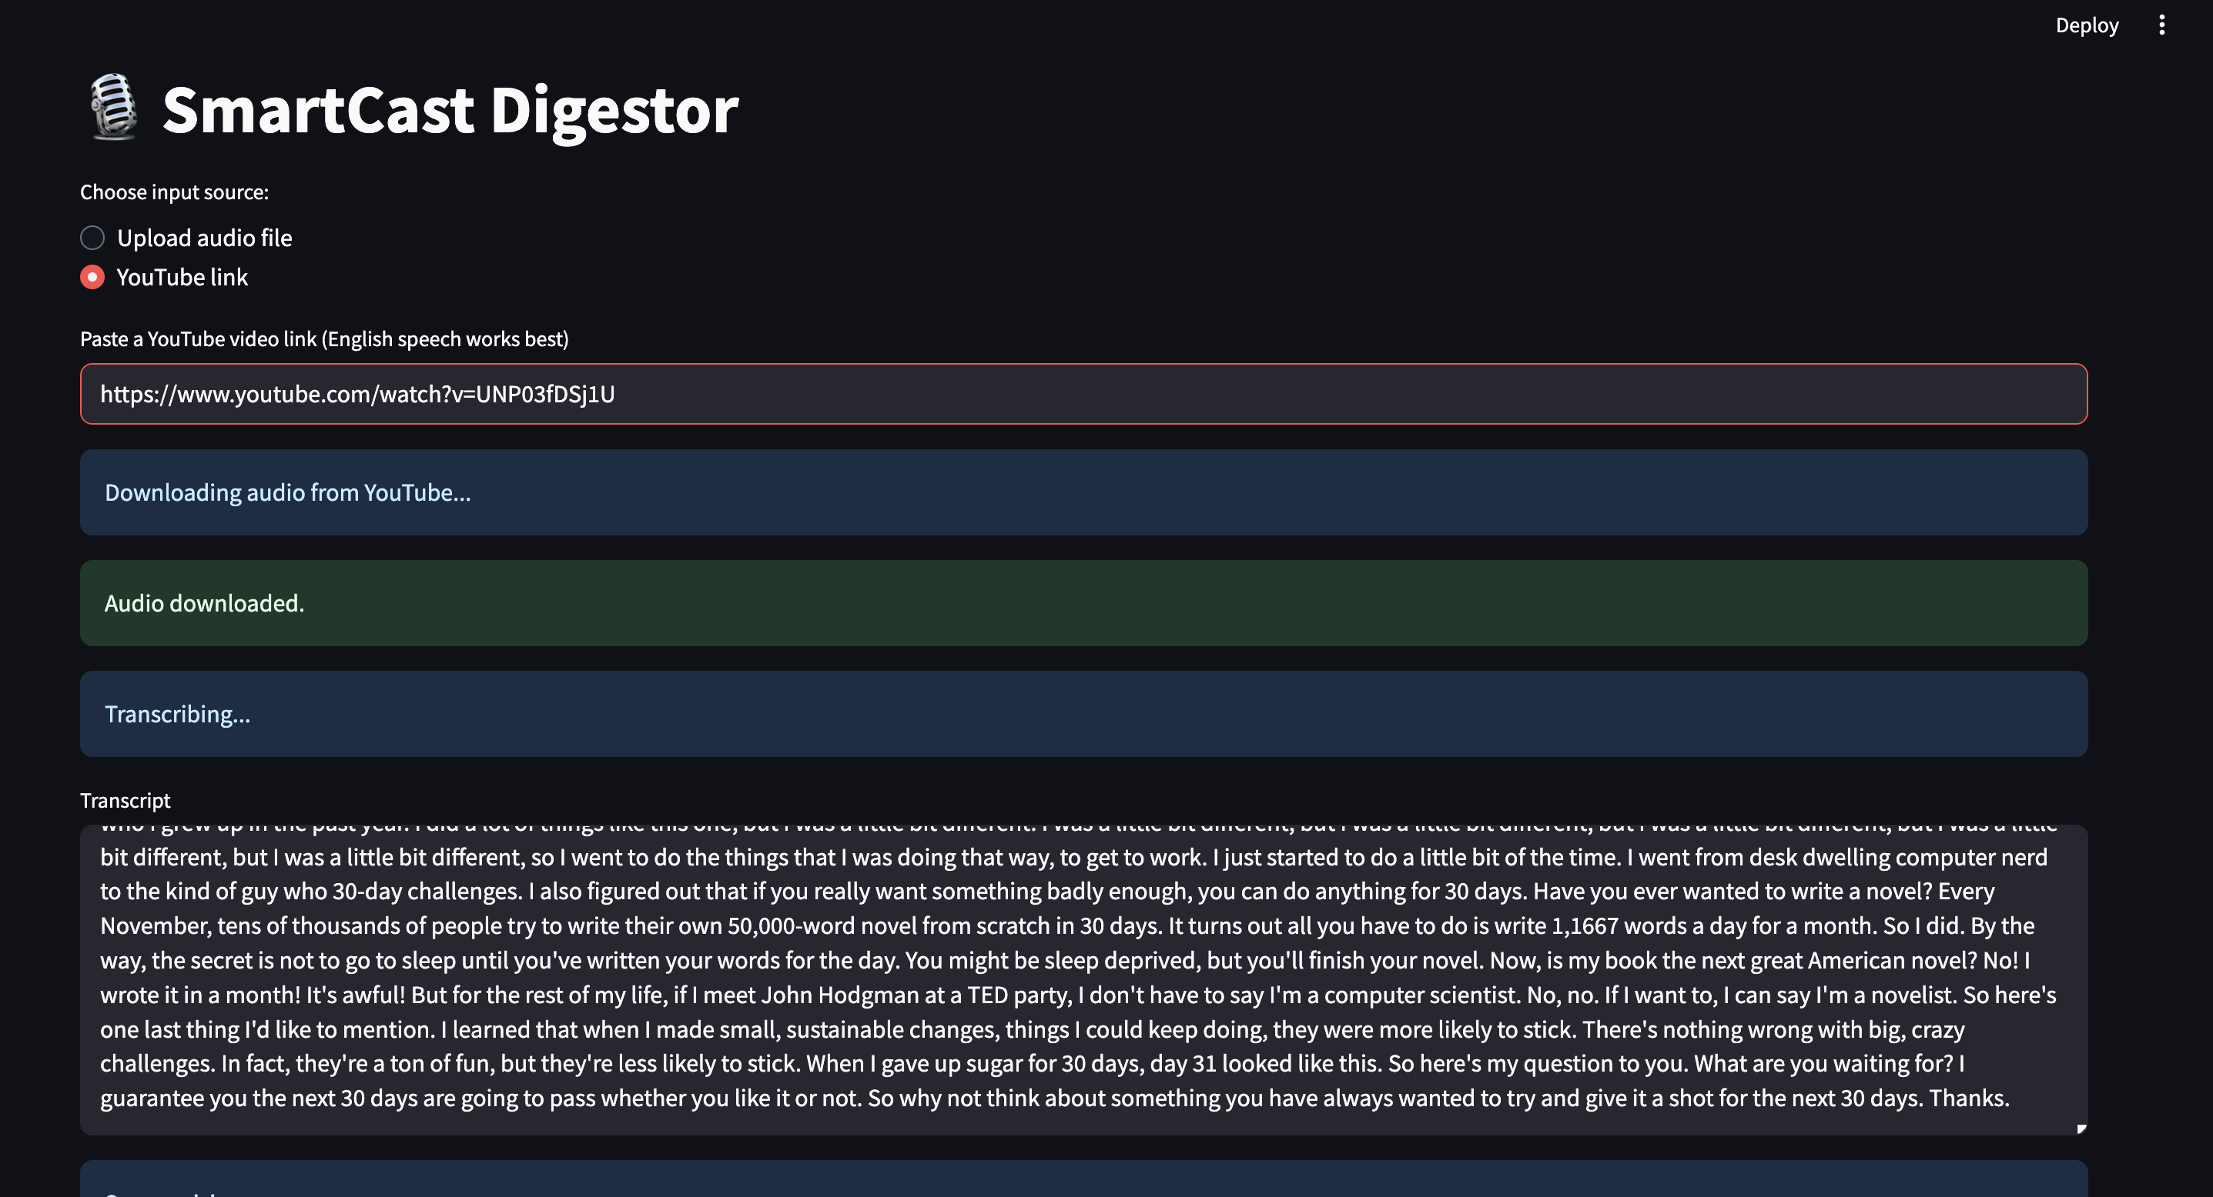

Slide 13
